Slide 1
Preprocessing for Offline Handwriting Recognition
東北大学大学院工学研究科
電子工学専攻川又研究室
Perttu Pitkänen

Slide 2
Overview
Introduction
Handwriting recognition
Preprocessing
Binarization
Sauvola algorithm
Property analysis
Conclusions
Future work

Slide 3
Introduction
Handwriting recognition (HWR) is the process of extracting text in digital form from handwritten images or input devices.
This phase of research concentrates on preprocessing.
Matlab was used for implementation.
IAM handwriting database provides wide variety of different handwriting styles in English.

Slide 4
Handwriting recognition
Used methods for handwriting recognition include Optical Character Recognition (OCR) or Intelligent Word Recognition (IWR).
OCR is used to recognize individual characters while IWR recognizes whole words.
Recognition process can be divided into three main phases:
Preprocessing
Feature extraction
Classification

Slide 5
Handwriting recognition
Each phase reduces the amount of data to be processed.
Preprocessing
Includes noise removal, binarization and segmentation.
Image is enhanced for feature extraction phase and the deteted objects are extracted.
Feature Extraction
Shape describing features are extracted from previously acquired objects.
Histogram of ordered gradients, horizontal and vertical histograms, topological features (loops, junctions)

Slide 6
Handwriting recognition
Classification
Extracted features are used in machine learning algorithms to create the feature vector.
The inputs are classified according to this vector.
For example simple k-means clustering can be applied to find the correct category for the input. In this case the feature vector can be constructed from previously mentioned features or their combinations.
For now the research has concentrated on preprocessing.

Slide 7
Preprocessing 1
During this research following preprocessing methods were considered:
Image aquisition
Noise removal
Binarization
Object property analysis
Object extraction

Slide 8
Preprocessing 2
Image is converted to grayscale
Noise is removed using 3x3 adaptive wiener filter
Adapts to the variation. More smoothing if variance is large.
3x3 neighbourhood optimal for most cases. Larger filter sizes resulted in exessive blur.
Histogram equalization is not applied because in most cases it increased the visibility of irrelevant objects such as paper texture and noise.

Slide 9
Binarization
Binarization is one of the most important parts of the preprocessing.
Image may have uneven lighting resulting in visible shadows or gloss.
Sauvola algorithm was designed for documant binarization purpose.
Sauvola algorithm resulted in best results with quick comparison with other algorithms.

Slide 10
Sauvola algorithm
Uses adaptive thresholding to binarize document images with uneven lightning or texture.
Enhanced version of Nilback binarization algorithm.
Can apply different algorithms to textual and non-textual areas of the image. (Nilback can only detect varying lightning)
1) Textual components
Histogram based method
Threshold control:
-Threshold decisions
- Interpolative adjustment
Hybrid switch:
Region type:
1)Text
2)Background
Gray-scale
document image
Bi-level
image
2) Non-textual components
Soft decision based method

Slide 11
Sauvola algorithm
One MATLAB implementation of Sauvola algorithm woks as follows.
BW = SAUVOLA(IMAGE, [M N], THRESHOLD, PADDING)
IMAGE = image file
[M N] = MxN neighbourhood
THRESHOLD = Nilback threshold, “sensitivity”
PADDING = method to handle border pixels e.g. ‘replicate’
BW = resulting binary image
Lower Nilback thresholds leave noise on image
Higher thresholds begin to lose information

Slide 12
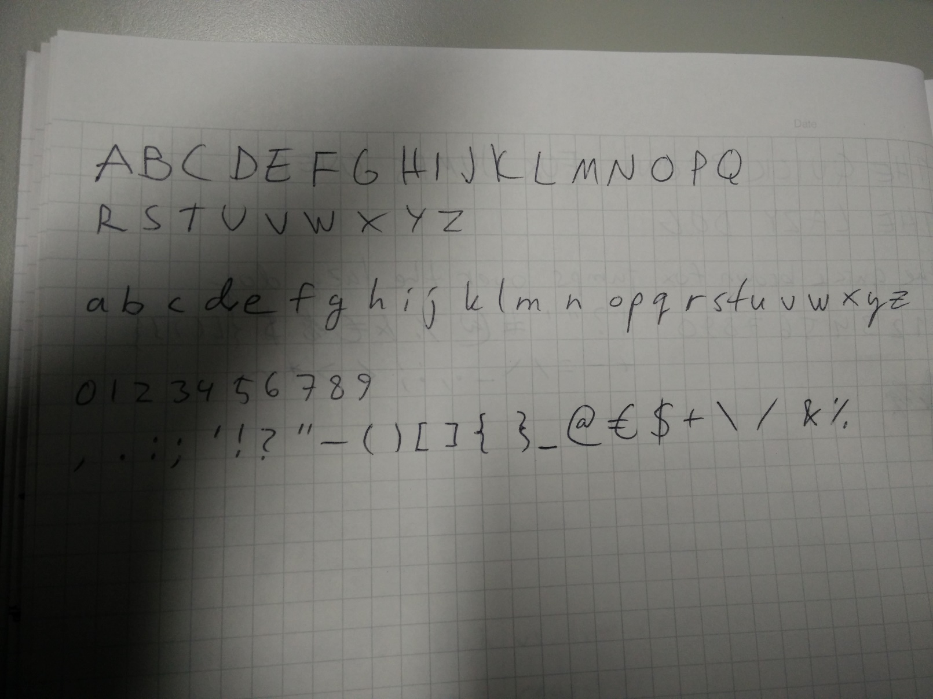
Original image

Slide 13
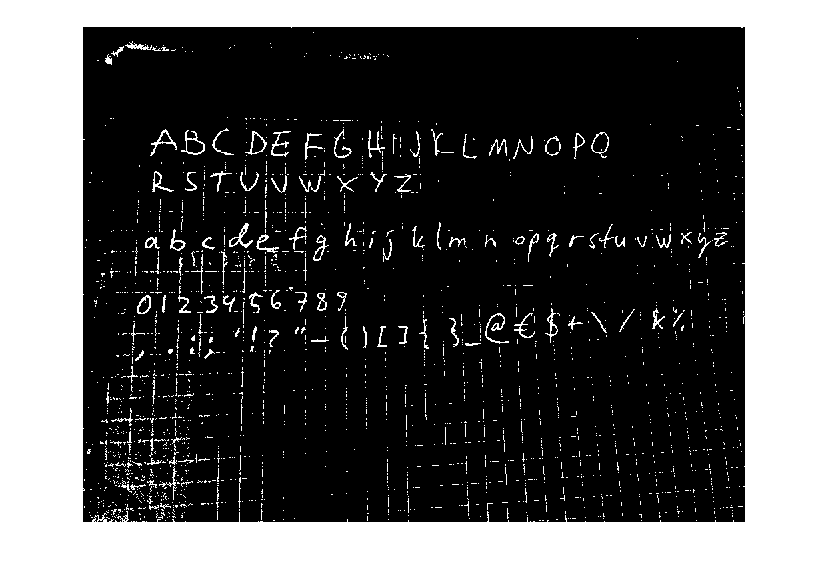
Image after binarization. Window size 100 threshold 0.1

Slide 14
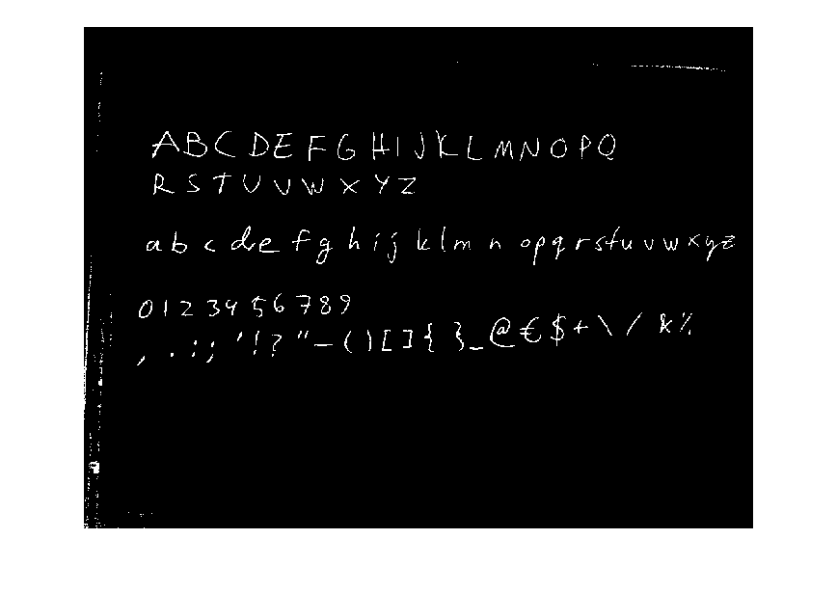
Image after binarization. Window size 100 threshold 0.4

Slide 15
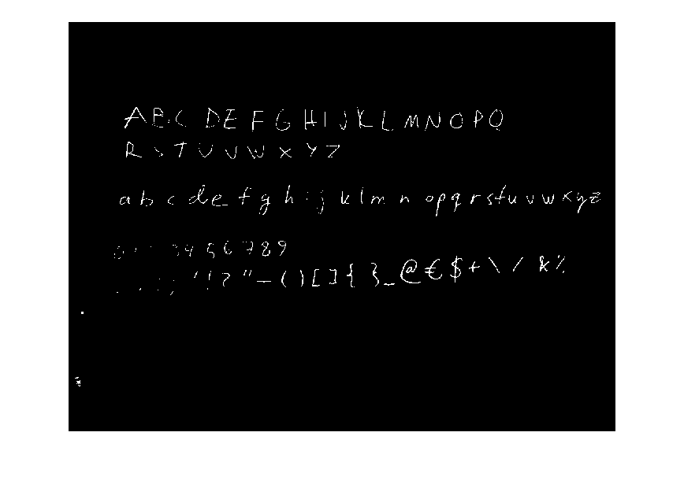
Image after binarization. Window size 100 threshold 0.9

Slide 16
Property analysis
Usually some irrelevant objects still remain after binarization.
Some object properties are analyzed and the objects are removed which have feature values outside the preferred values.
Example object properties include area, major axis length and Euler number (Number of objects in the region minus the number of holes in those objects).

Slide 17
Image after binarization. Window size 100 threshold 0.4

Slide 18
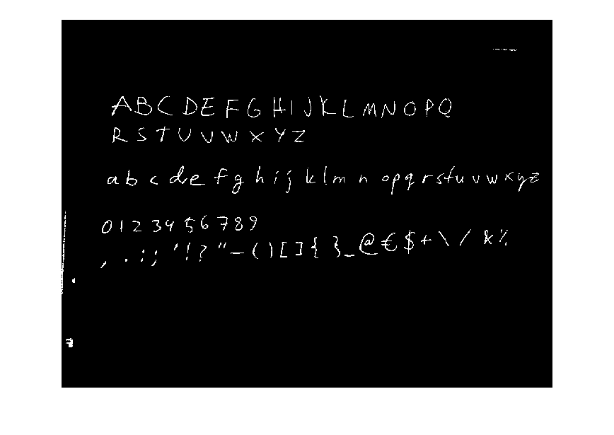
Areas smaller than 200 pixels removed

Slide 19
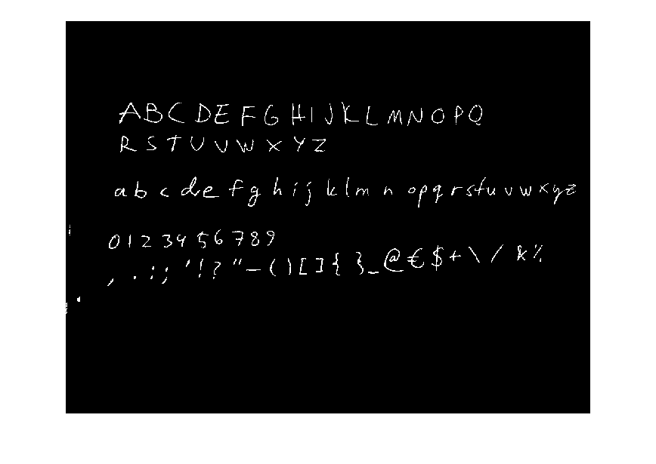
Areas with Euler numbers smaller than -4 removed

Slide 20
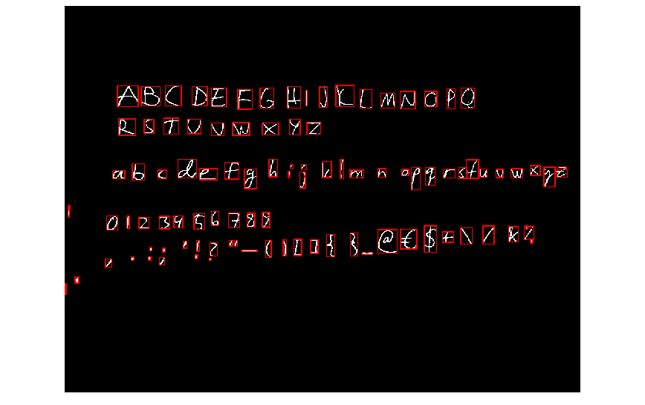
Found objects (Some irrelevant objects remain)

Slide 21
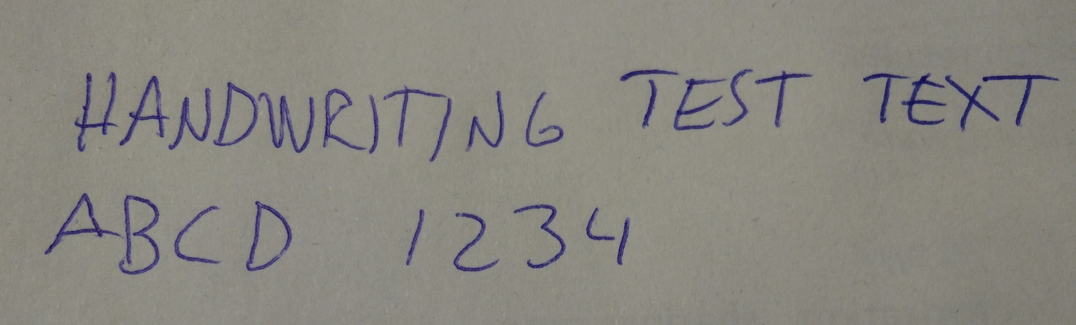

Errors with different image and same parameters
(Lighter pen caused more holes in objects
which then caused Euler number to be lower than expected.)

Slide 22
Conclusions
Chosen methods are useful in preprocessing.
Chosen arguments will work only for the specific case.
Problems:
Human handwriting can vary a lot even with same person.
Different size and thickness with letters.
Different color pens or pencils.
Differing image resolutions.
Solutions:
Keep resolution as constant.
Try to find optimal stroke width without prior information.
Apply morphological closing to remove small holes.

Slide 23
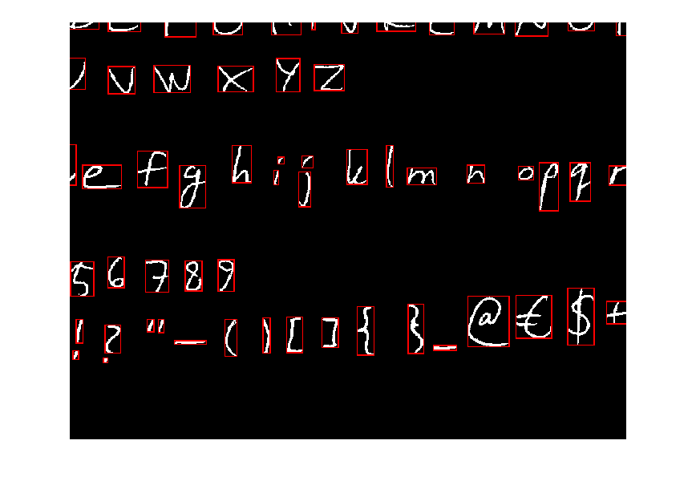
Future work
Enhance the preprocessing making it less dependant on arguments.
Combine letters and symbols containing separate elements. (i j ! ? ” = ; : %)

Slide 24
Future work 2
Layout analysis. Detect words, rows and columns of text.
Feature extraction:
Vertical and horizontal histograms.
Histogram of ordered gradients.
Topological features such as endpoints, loops and junctions.
Classification with k-means clustering.
Use IAM database for large scale tests.

Slide 25
図形のデフォルト設定
ブロック（四角）や線（矢印）の線の太さは2ptとする
このデザインテンプレートでは，ブロックは塗りつぶしなしで，線の太さは2ptになるようにしている．
例：
矢印については，終点のスタイルを右上のタイプとし，サイズを右下の一番大きいものとしておく．
例：

Slide 26
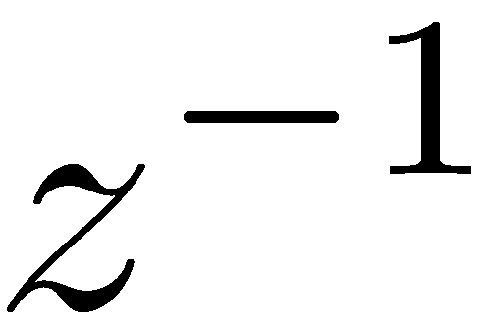

ディジタルフィルタの基本要素
$$z^{−1}$$
TeXpoint版
数式ツール版

Slide 27
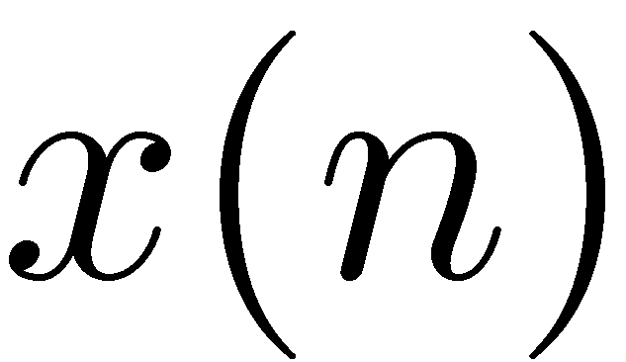
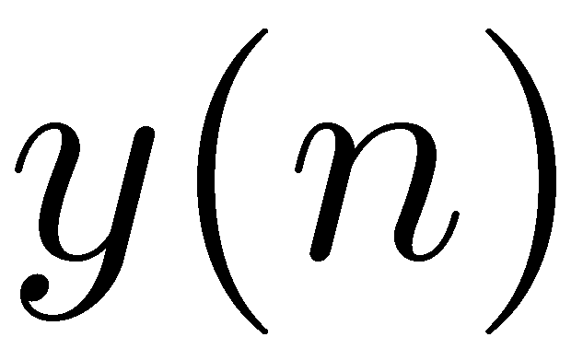
ディジタルフィルタの基本要素の接続
ブロック間はオートシェープのコネクタを使用して接続する．
コネクタが若干傾く場合は，ブロックを上下左右に移動させると，
どちらかの方向からか移動させた場合に傾きが取れる．

Slide 28




ディジタルフィルタの基本要素の接続（数式ツール版）
$$x\left(n\right)$$
$$z^{−1}$$
$$z^{−1}$$
$$y\left(n\right)$$
ブロック間はオートシェープのコネクタを使用して接続する．
コネクタが若干傾く場合は，ブロックを上下左右に移動させると，
どちらかの方向からか移動させた場合に傾きが取れる．

Slide 29
ブロック内の文字
ブロック内にはこのように
文字が入力できる

Slide 30
MATLAB用標準カラーマップ
MATLAB 2015aからは，グラフなどに使用するカラーマップが新しくなりました．この新しい色を参考までに以下に用意しました．これらの色は，プロジェクタなどに表示した際にも見やすい色になっています．（従来の色は明るすぎて見にくい場合がありました．）

